Slide 1
“Nuts and Bolts” Youth Apprenticeship
Overview
Josh Fassl, Director
Notes:
Josh Fassl from Dane County School Consortium places interns and apprentices at businesses throughout Dane County and will discuss the ins and outs of bringing on an intern, will explain how to begin, and the potential challenges of having an intern.
Stand up if you went to college, any college. Stay standing if you are working in the field that your got your degree in?
Schools love to taught AP tests, ACT scores, and College entrance….but did you know, that we send almost 70% of our HS graduates to a 4 year college, but only 1/3 of them graduate?
There’s a program that helps students graduate college at a rate of almost double of the national average……Youth Apprenticeship!

Slide 2
Wisconsin Youth Apprenticeship
Academic Instruction
Started 1991
11 Cluster Areas
55+ Career Pathways
Integrates Academic and Career Preparation
Technical Instruction
Work-Based Learning

Slide 3
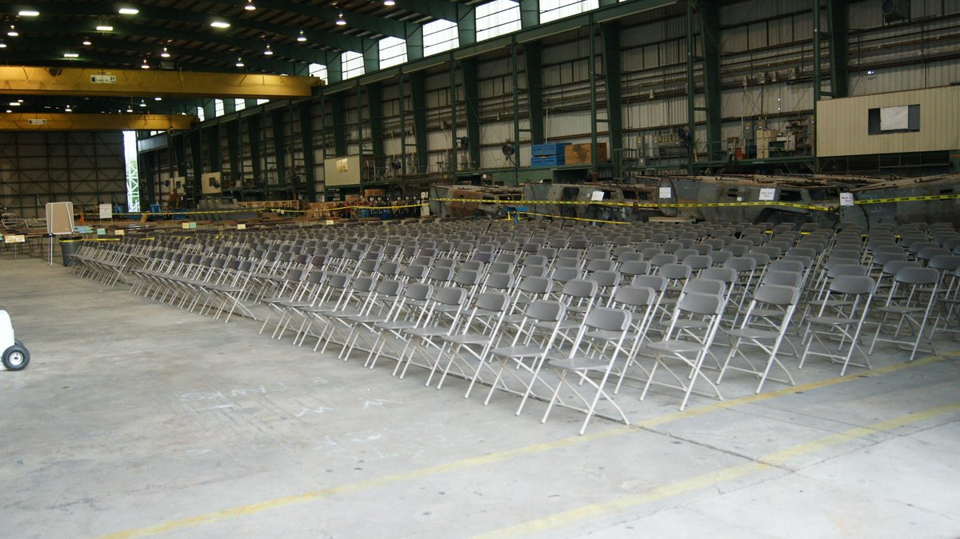
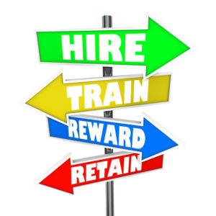
7
EMPLOYER BENEFITS OF YOUTH APPRENTICESHIP
THROUGH THE DCSC
YA BY THE NUMBERS
Over 260 students from 14 districts in Dane County
86% of students go on to post-secondary education
85% of students were offered employment after their apprenticeship was completed
200+ employers are participating in Youth Apprenticeship through the
Dane County School Consortium

Slide 4
Employer Expectations
Interview applicants
Provide a mentor
Provide a “well-rounded” experience
Provide a competitive wage to student
Have available 10-20 hours per week during school and 20-30 hours per week in summer
Notes:
Maintain your Hiring process…
Mentor to train and show students the correct way
Wide variety of opportunities…coach into the industry.

Slide 5
Who is an “Youth-Apprentice”
Junior or Senior in HS, (must be 16)
Students have a detailed individual career plan
Have demonstrated appropriate school behavior
Student grades/attendance are satisfactory
Student will have 180 hours of related “industry” instruction (360 for Level II).
Student will complete 450 hours of paid occupational work experience (900 for Level II)
Notes:
Prior Coursework in pathway
Pre-screened by school staff

Slide 6
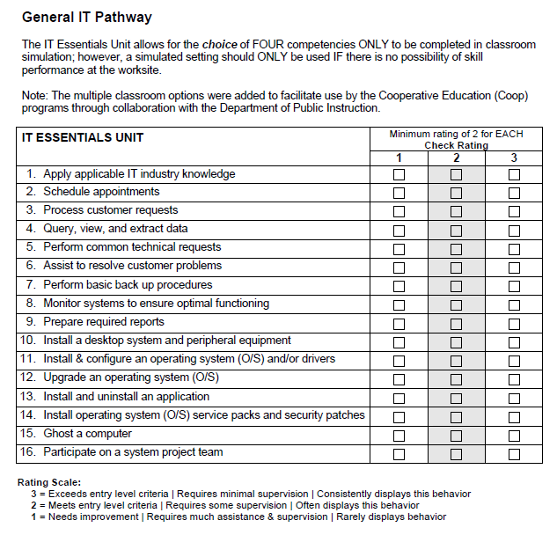
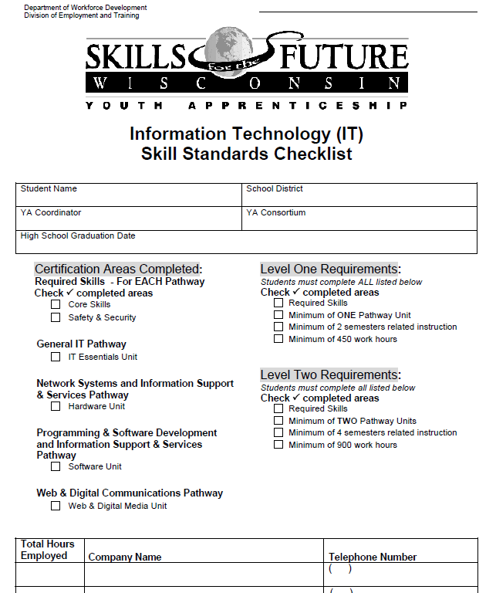
Sample IT Skills Checklist
Notes:
Checklist is just the “Minimum” Training Expectations…Employers will certify skills.

Slide 7
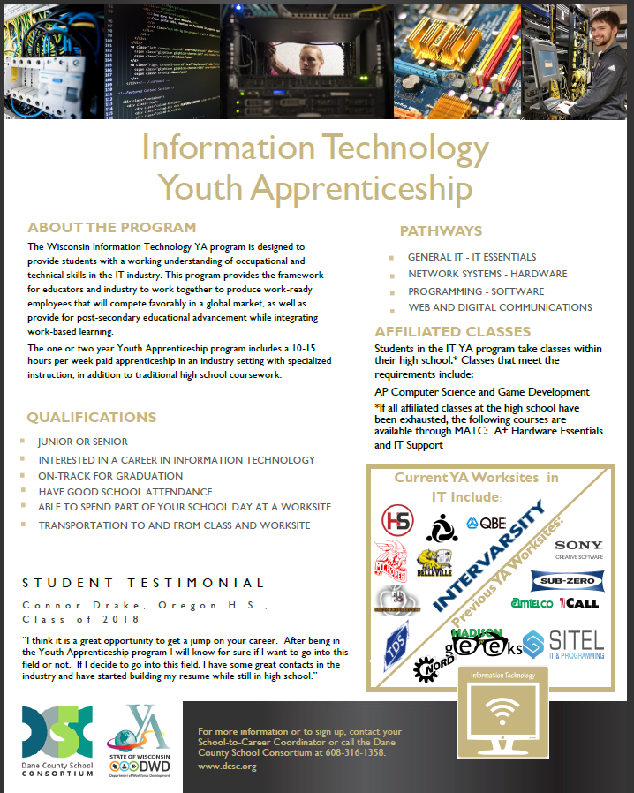
YA Related Instruction

Slide 8
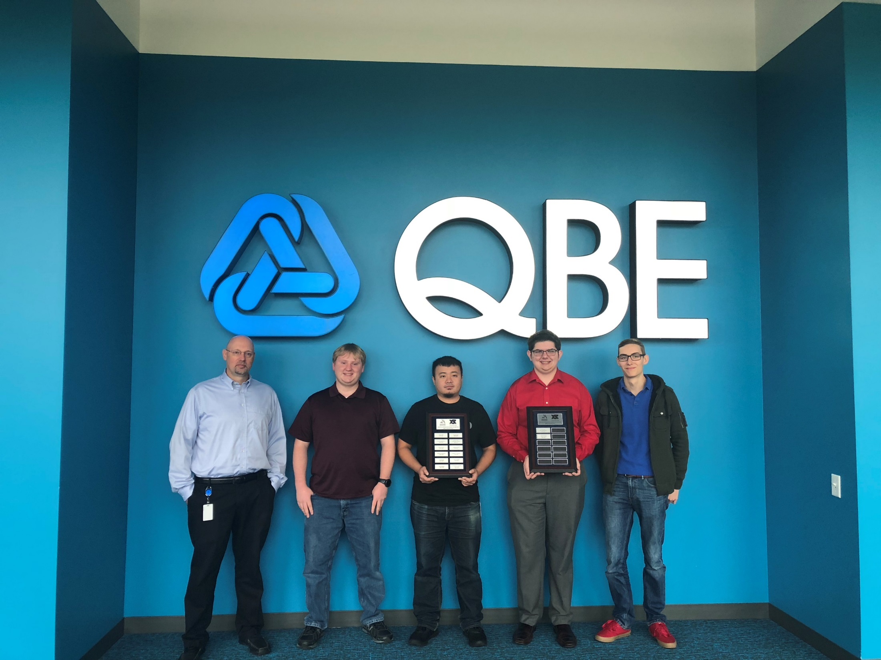
Notes:
Tony Walton has mentored over 12 IT students at QBE….

Slide 9
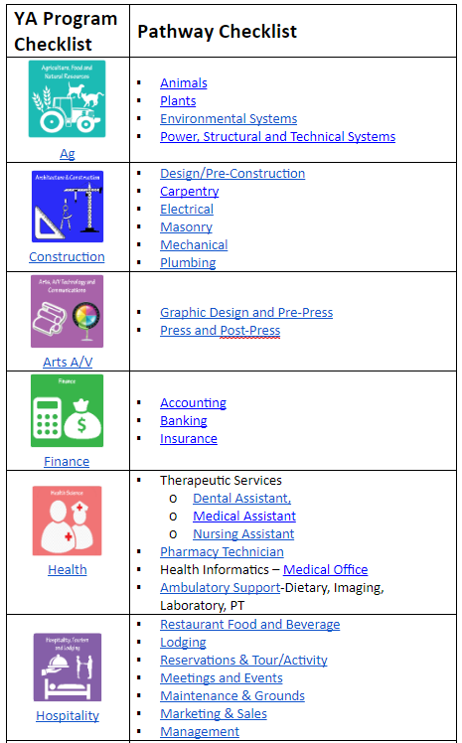
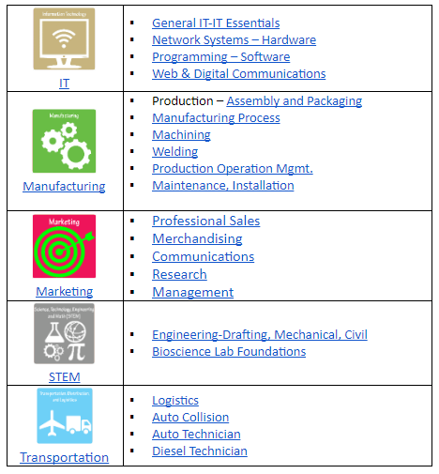
YA Employment Pathways

Slide 10
Tips for a Successful YA Placement
Attend Mentor Training
Set student schedule
Communicate expectations
Teach “phone” expectations
Provide opportunities for growth
Demonstrate procedures

Slide 11
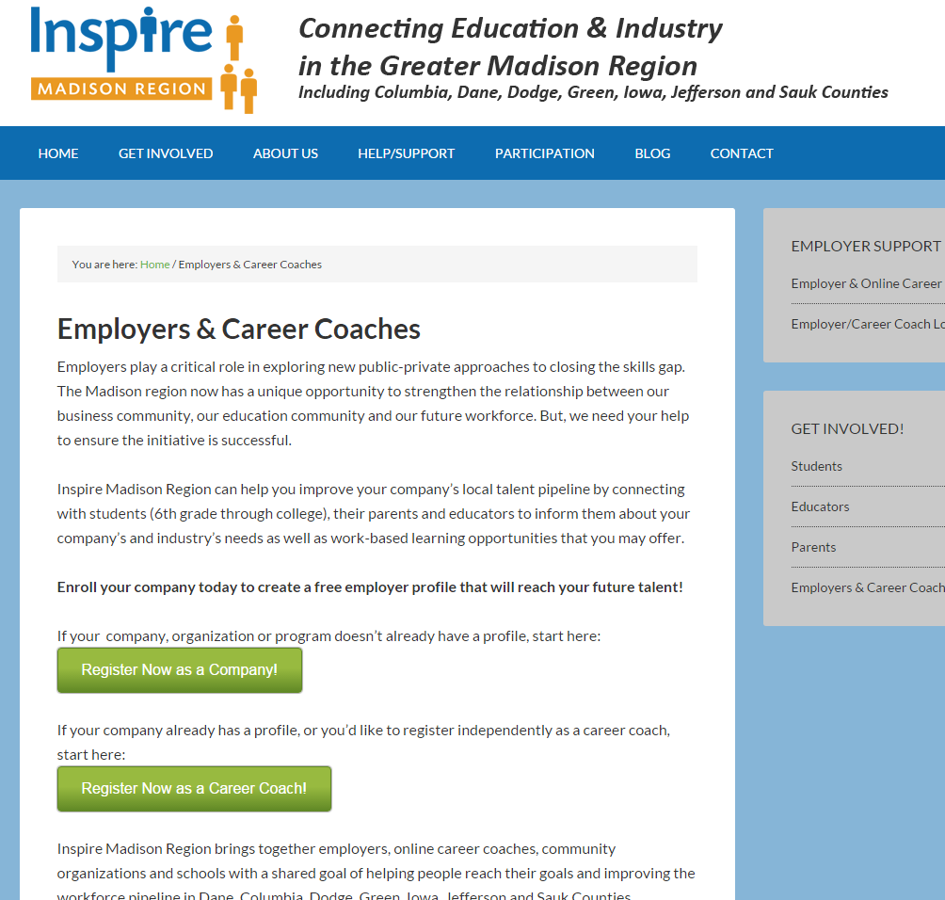
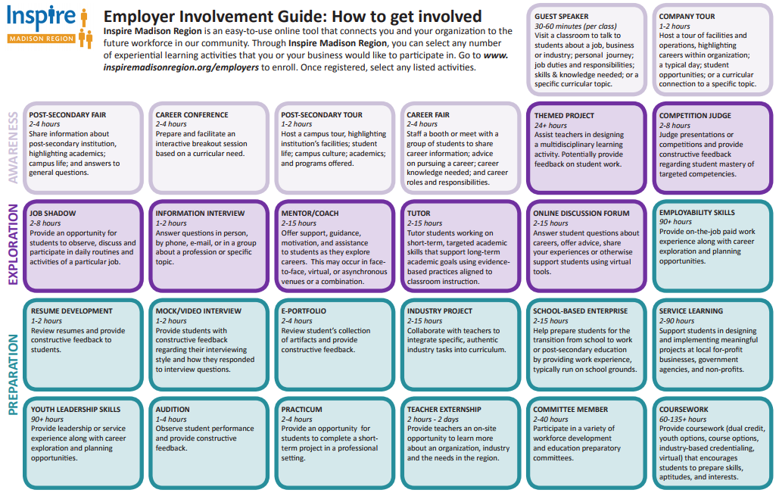
Other Ways to Connect with Students
http://inspiremadisonregion.org/employers/
Notes:
Experiential Activities: guest speakers, field trips, job shadows.
Career Coach
Mention: Gene-Dahloff (Mad Rep). Is here!

Slide 12
Youth Apprenticeship Panel
Jacob Sondreal – YA Alumni, Current RA, Dave Jones
Ron Roehl –YA Mentor, CEO, CNC Solutions
Thomas Duffy, YA Mentor, President and Owner, Commercial Air
Scott Baumann – Team Lead, QBE (via video)
Notes:
1. Jacob - Tell us about your YA experience, what was your initial plan? What jobs did you perform?
2. Ron-Tell us about why you’ve chosen to be involved with your school district, and the YA program
3. Thom – Tell us how the YA program has helped your business? 4. Jacob - How did your career path change during your YA experience. 5. Ron - Are the students valuable to your company. How much extra time does the "mentoring" take
6. Thom – Tell us about your mentoring process? 7. Jacob – Did the Youth Apprenticeship program prepare you for your RA?
8. Ron – What should other companies who are considering Youth Apprenticeship know?
9. Thom –What value is there to participating in the Youth Apprentice program?

